Slide 1
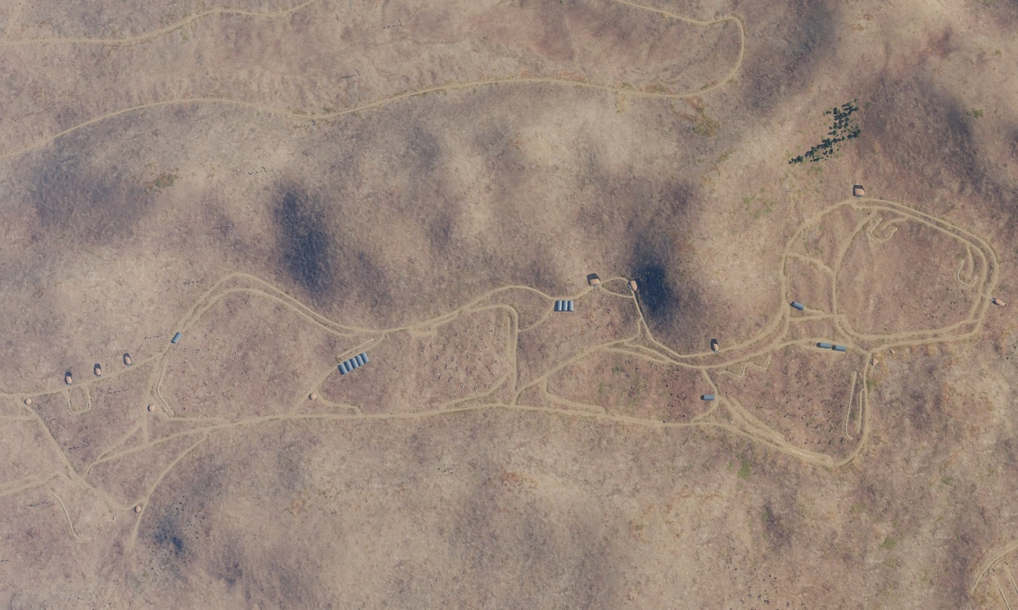

SYTGT004 923rd SCUD Regiment Base
N
Missile Bunkers
7
5
8
4
6
10
4
3
9
1
2
DESCRIPTION OF THE DESIRED POINTS OF IMPACT WITH WPN TYPE:
SYTGT004A – Missile/TEL Bunkers
DPI 1 N33 20.559 E 036 21.720/2274ft/(2000 Ibs bomb)
DPI 2 N33 20.560 E036 21.640/2283ft/(2000 Ibs bomb)
DPI 3 N33 20.555 E036 21.555/2287ft/(2000 Ibs bomb)
SYTGT004B – Missile/TEL Bunkers
DPI 4 N33 20.684 E036 20.286/2461ft/(2000 Ibs bomb)
DPI 5 N33 20.729 E036 20.174/2497ft /(2000 Ibs bomb)
DPI 6 N3320.911 E036 20.021/2431ft/(2000 Ibs bomb)
SYTGT004C – Missile/TEL Bunkers
DPI 7 N33 20.661 E036 19.515/2589ft /(2000 Ibs bomb)
DPI 8 N33 21.008 E036 19.254/2539ft /(2000 Ibs bomb)
DPI 9 N33 21.050 E036 19.573/2503ft/(2000 Ibs bomb)
DPI 10 N33 21.058 E036 19.626/2493ft/(2000 Ibs bomb)
SYTGT004D – Regiment HQ
DPI 11 N33 20.591 E036 21.839/2257ft/(2000 Ibs bomb)
11
Regiment HQ
4
5
6
7
8

Slide 2
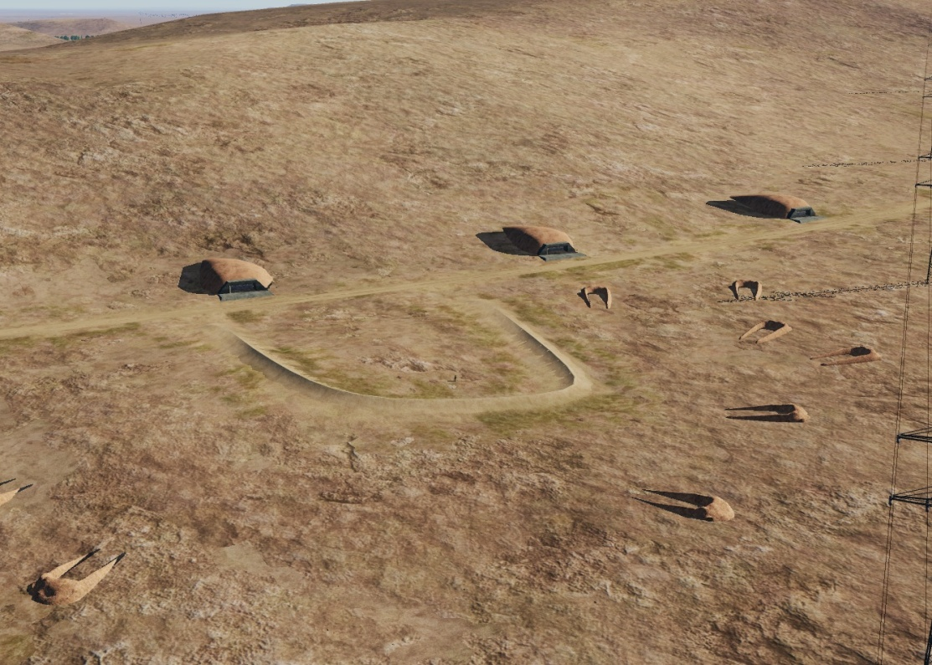
SYTGT004 923rd SCUD Regiment Base
N
N
SYTGT004A
3 x Missile and TEL Vehicle Bunkers made of concrete slab supported by reinforced concrete base and pillars, flat poured roof, covered with 2 metres of earth. Requires delayed fuzing.
Suggested fuzing solution on DPIs 1-3 – contact to open up the roof followed by delayed to pierce through and affect the bunker structure and contents.
3
2
1
1
SYTGT004A

Slide 3
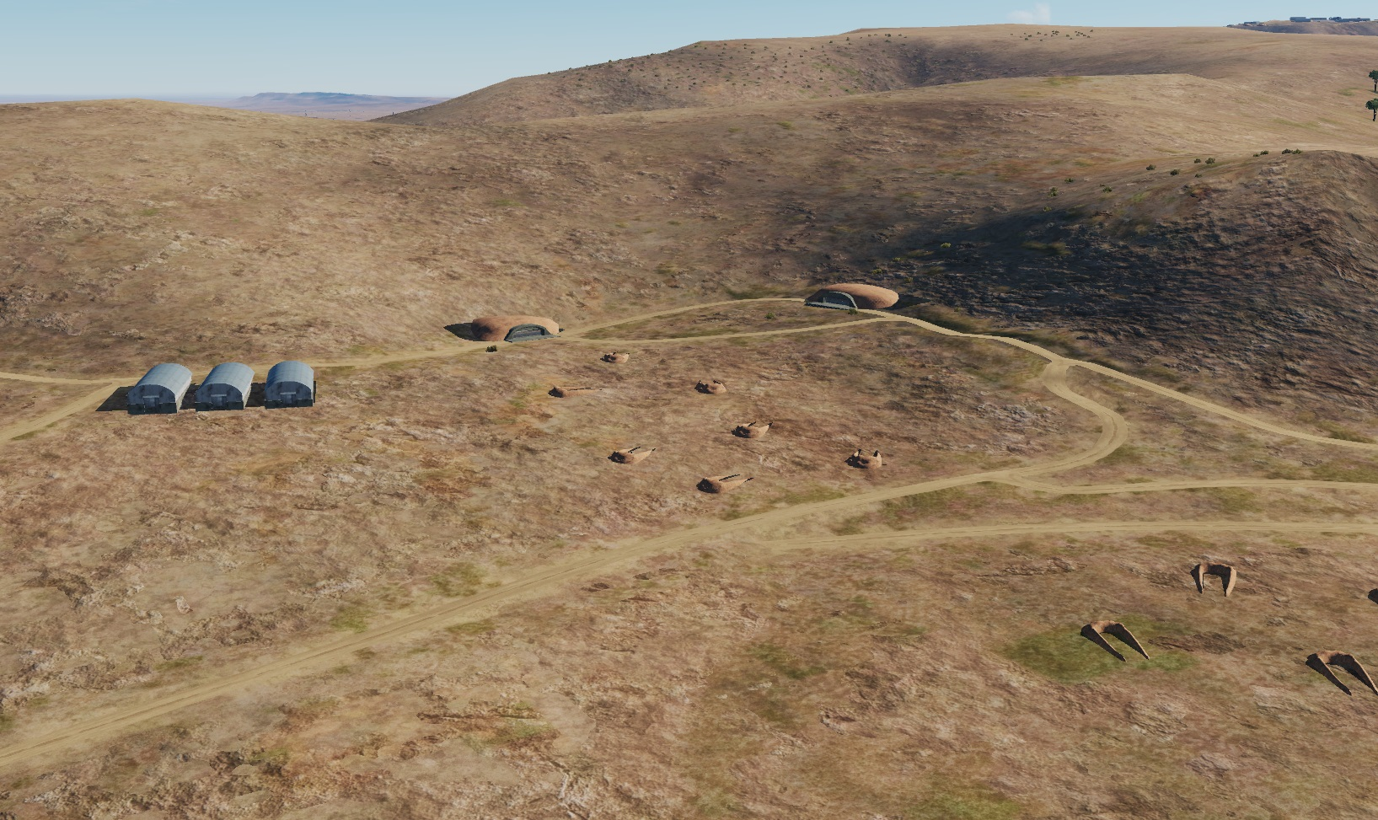
SYTGT004 923rd SCUD Regiment Base
SYTGT004B
3 x Missile and TEL Vehicle Bunkers made of concrete slab supported by reinforced concrete base and pillars, flat poured roof, covered with 2 metres of earth. Requires delayed fuzing.
Suggested fuzing solution on DPIs 4-6 – contact to open up the roof followed by delayed to pierce through and affect the bunker structure and contents.
N
N
5
1
4
SYTGT004B

Slide 4
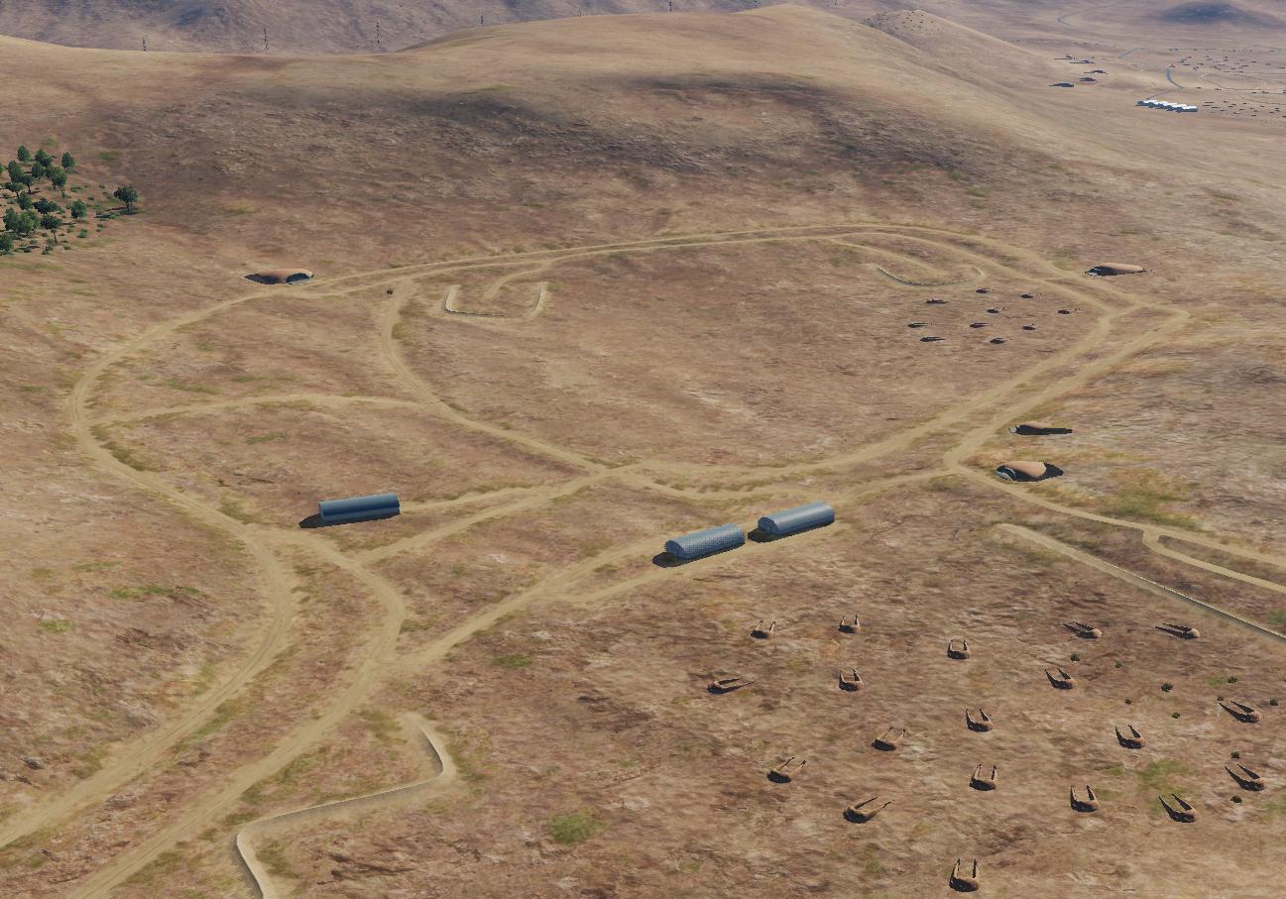
SYTGT004 923rd SCUD Regiment Base
SYTGT004B
3 x Missile and TEL Vehicle Bunkers made of concrete slab supported by reinforced concrete base and pillars, flat poured roof, covered with 2 metres of earth. Requires delayed fuzing.
Suggested fuzing solution on DPIs 7-10 – contact to open up the roof followed by delayed to pierce through and affect the bunker structure and contents.
N
N
7
8
1
9
10
SYTGT004C

Slide 5
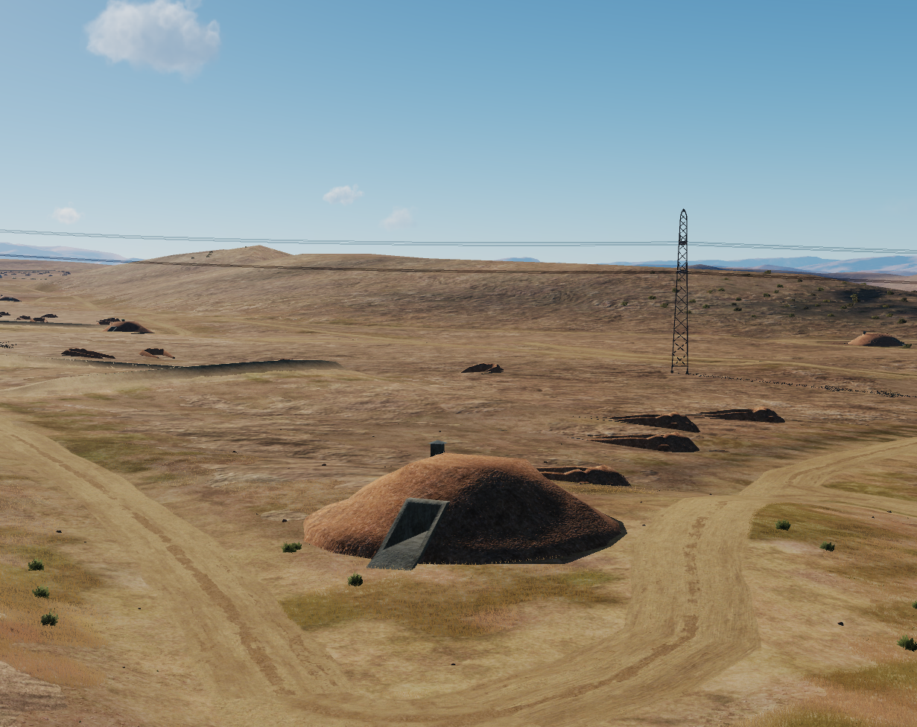
SYTGT004 923rd SCUD Regiment Base
SYTGT004D
Regimental Headquarters, made of concrete slab supported by reinforced concrete base and pillars, flat poured roof, covered with 2 metres of earth. Requires delayed fuzing.
Suggested fuzing solution on DPI 11– contact to open up the roof followed by delayed to pierce building and affect the structure and contents.
N
SYTGT004D
N
1
11

